Slide 1
Mental set
Kahoot
Notes:
hook

Slide 2
24
7
30
Date
Title
EQ –
5
Notes:
Lesson objective (EQ)

Slide 3
Lesson objective
By the end of this lesson you will be able to;
- Use all 4 operations with Algebraic Fractions with Algebraic Denominators
Notes:
Lesson

Slide 4
Success Criteria
You will know you are successful in achieving the objective by…

Slide 5
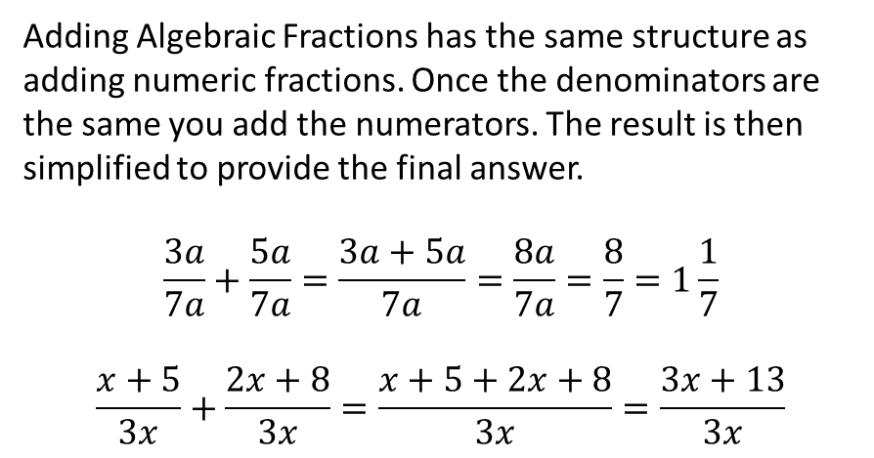
24
7
30
Date
Algebraic Fractions
EQ – How to use Addition with algebraic fractions with algebraic denominators.
Adding Algebraic Fractions has the same structure as adding numeric fractions. Once the denominators are the same you add the numerators. The result is then simplified to provide the final answer.
$$\frac{3a}{7a}+\frac{5a}{7a}=\frac{3a+5a}{7a}=\frac{8a}{7a}=\frac{8}{7}=1\frac{1}{7}$$
$$\frac{x+5}{3x}+\frac{2x+8}{3x}=\frac{x+5+2x+8}{3x}=\frac{3x+13}{3x}$$
1
Notes:
Input

Slide 6
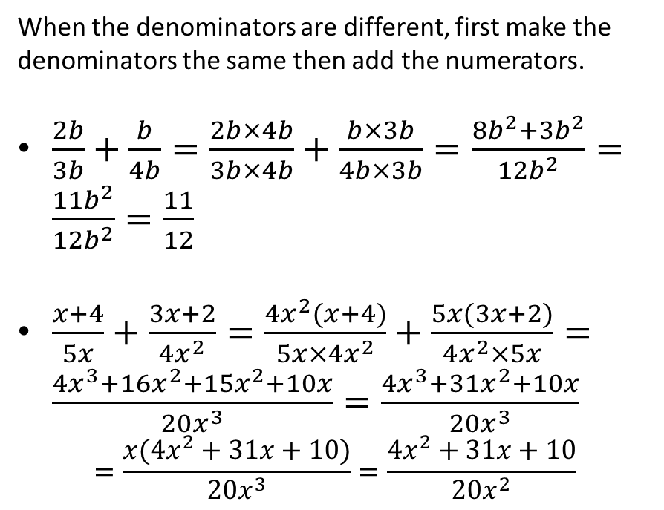
24
7
30
Date
Algebraic Fractions
EQ – How to use Addition with algebraic fractions with algebraic denominators.
When the denominators are different, first make the denominators the same then add the numerators.
$\frac{2b}{3b}+\frac{b}{4b}=\frac{2b×4b}{3b×4b}+\frac{b×3b}{4b×3b}=\frac{8b^{2}+3b^{2}}{12b^{2}}=\frac{11b^{2}}{12b^{2}}=\frac{11}{12}$
$\frac{x+4}{5x}+\frac{3x+2}{4x^{2}}=\frac{4x^{2}(x+4)}{5x×4x^{2}}+\frac{5x(3x+2)}{4x^{2}×5x}=\frac{4x^{3}+16x^{2}+15x^{2}+10x}{20x^{3}}=\frac{4x^{3}+31x^{2}+10x}{20x^{3}}$
$$=\frac{x(4x^{2}+31x+10)}{20x^{3}}=\frac{4x^{2}+31x+10}{20x^{2}}$$
2
Notes:
Input

Slide 7
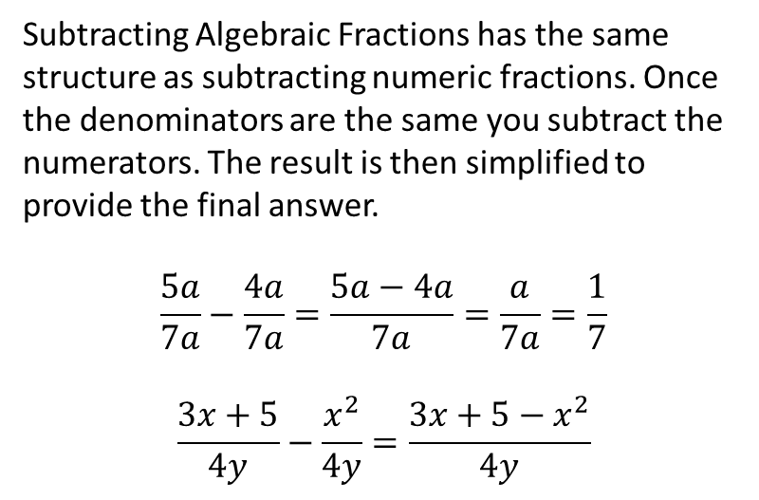
24
7
30
Date
Algebraic Fractions
EQ – How to use Subtraction with algebraic fractions with algebraic denominators.
Subtracting Algebraic Fractions has the same structure as subtracting numeric fractions. Once the denominators are the same you subtract the numerators. The result is then simplified to provide the final answer.
$$\frac{5a}{7a}−\frac{4a}{7a}=\frac{5a−4a}{7a}=\frac{a}{7a}=\frac{1}{7}$$
$$\frac{3x+5}{4y}−\frac{x^{2}}{4y}=\frac{3x+5−x^{2}}{4y}$$
3
Notes:
Input

Slide 8
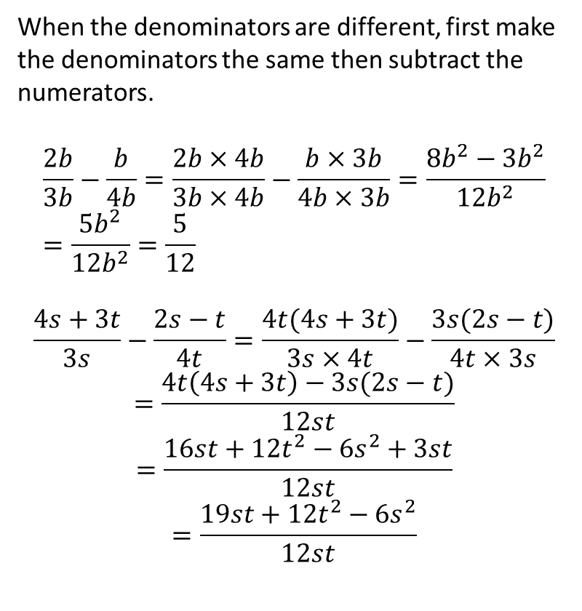
24
7
30
Date
Algebraic Fractions
EQ – How to use Subtraction with algebraic fractions with algebraic denominators.
When the denominators are different, first make the denominators the same then subtract the numerators.
$$\frac{2b}{3b}−\frac{b}{4b}=\frac{2b×4b}{3b×4b}−\frac{b×3b}{4b×3b}=\frac{8b^{2}−3b^{2}}{12b^{2}}=\frac{5b^{2}}{12b^{2}}=\frac{5}{12}$$
$$\frac{4s+3t}{3s}−\frac{2s−t}{4t}=\frac{4t(4s+3t)}{3s×4t}−\frac{3s(2s−t)}{4t×3s}$$
$$=\frac{4t\left(4s+3t\right)−3s(2s−t)}{12st}$$
$$=\frac{16st+12t^{2}−6s^{2}+3st}{12st}$$
$$=\frac{19st+12t^{2}−6s^{2}}{12st}$$
4
Notes:
Input

Slide 9
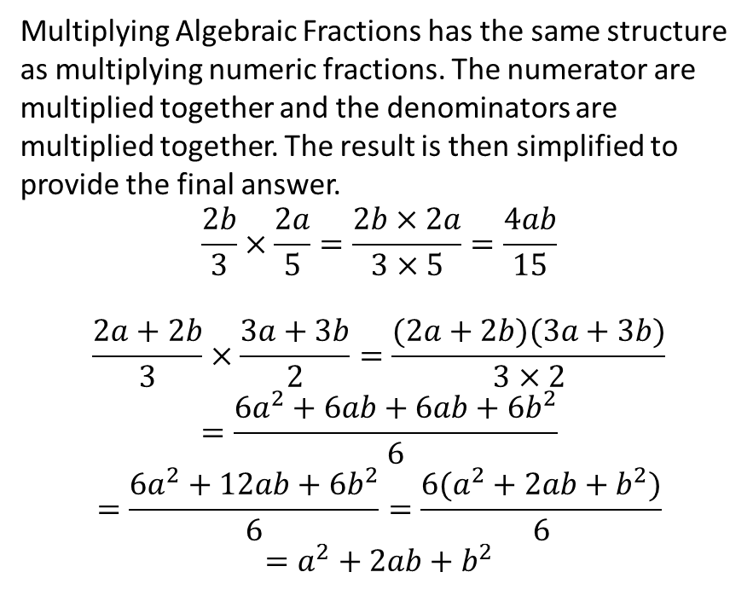
24
7
30
Date
Algebraic Fractions
EQ – How to use multiplication with algebraic fractions with numerical denominators.
Multiplying Algebraic Fractions has the same structure as multiplying numeric fractions. The numerator are multiplied together and the denominators are multiplied together. The result is then simplified to provide the final answer.
$$\frac{2b}{3}×\frac{2a}{5}=\frac{2b×2a}{3×5}=\frac{4ab}{15}$$
$$\frac{2a+2b}{3}×\frac{3a+3b}{2}=\frac{(2a+2b)(3a+3b)}{3×2}$$
$$=\frac{6a^{2}+6ab+6ab+6b^{2}}{6}$$
$$=\frac{6a^{2}+12ab+6b^{2}}{6}=\frac{6(a^{2}+2ab+b^{2})}{6}$$
$$=a^{2}+2ab+b^{2}$$
5
Notes:
Input

Slide 10
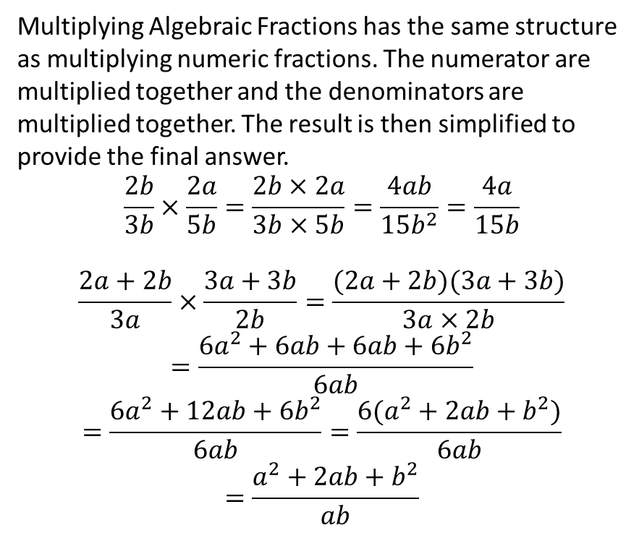
24
7
30
Date
Algebraic Fractions
EQ – How to use multiplication with algebraic fractions with algebraic denominators.
Multiplying Algebraic Fractions has the same structure as multiplying numeric fractions. The numerator are multiplied together and the denominators are multiplied together. The result is then simplified to provide the final answer.
$$\frac{2b}{3b}×\frac{2a}{5b}=\frac{2b×2a}{3b×5b}=\frac{4ab}{15b^{2}}=\frac{4a}{15b}$$
$$\frac{2a+2b}{3a}×\frac{3a+3b}{2b}=\frac{(2a+2b)(3a+3b)}{3a×2b}$$
$$=\frac{6a^{2}+6ab+6ab+6b^{2}}{6ab}$$
$$=\frac{6a^{2}+12ab+6b^{2}}{6ab}=\frac{6(a^{2}+2ab+b^{2})}{6ab}$$
$$=\frac{a^{2}+2ab+b^{2}}{ab}$$
6
Notes:
Input

Slide 11
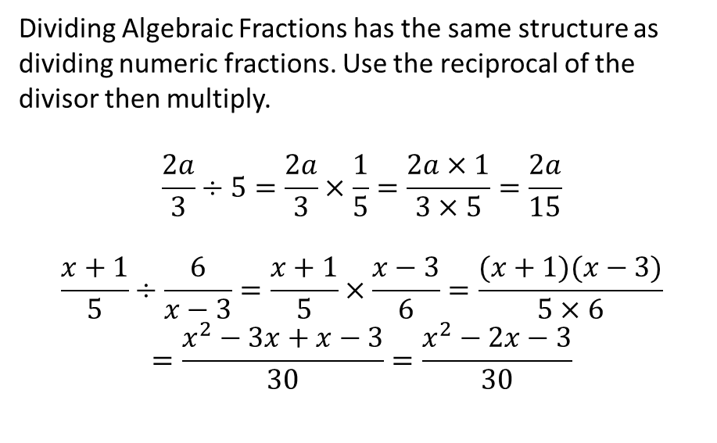
24
7
30
Date
Algebraic Fractions
EQ – How to use Division with algebraic fractions with numerical denominators.
Dividing Algebraic Fractions has the same structure as dividing numeric fractions. Use the reciprocal of the divisor then multiply.
$$\frac{2a}{3}÷5=\frac{2a}{3}×\frac{1}{5}=\frac{2a×1}{3×5}=\frac{2a}{15}$$
$$\frac{x+1}{5}÷\frac{6}{x−3}=\frac{x+1}{5}×\frac{x−3}{6}=\frac{(x+1)(x−3)}{5×6}$$
$$=\frac{x^{2}−3x+x−3}{30}=\frac{x^{2}−2x−3}{30}$$
6
Notes:
Input

Slide 12
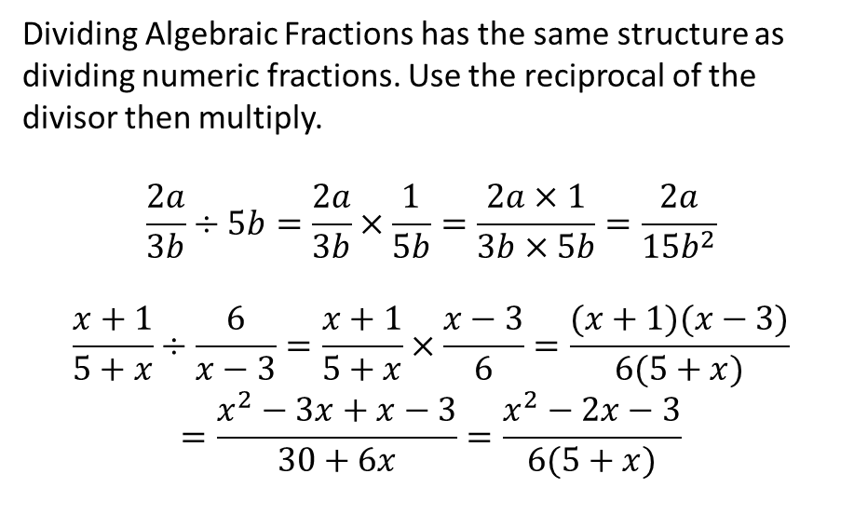
24
7
30
Date
Algebraic Fractions
EQ – How to use Division with algebraic fractions with algebraic denominators.
Dividing Algebraic Fractions has the same structure as dividing numeric fractions. Use the reciprocal of the divisor then multiply.
$$\frac{2a}{3b}÷5b=\frac{2a}{3b}×\frac{1}{5b}=\frac{2a×1}{3b×5b}=\frac{2a}{15b^{2}}$$
$$\frac{x+1}{5+x}÷\frac{6}{x−3}=\frac{x+1}{5+x}×\frac{x−3}{6}=\frac{(x+1)(x−3)}{6(5+x)}$$
$$=\frac{x^{2}−3x+x−3}{30+6x}=\frac{x^{2}−2x−3}{6(5+x)}$$
6
Notes:
Input

Slide 13
Check for understanding
Notes:
Check for understanding

Slide 14

Guided Practice
$$\frac{8h−9}{7}+\frac{9h−5}{6}$$
$$\frac{2r+7}{12}−\frac{6r−7}{18}$$
$$\frac{3q−7}{8}×\frac{7q−4}{5}$$
$$\frac{9e}{2}÷\frac{6h}{7}$$
Notes:
Guided practice

Slide 15
Activity
Nelson Chapter 3 – Pages 128 & 129
Q1 – a, d, g, j, o, r, u, x
Q2 – k, n, q, t
Q3 – d, f, k, o
Q4 – c, i, p, s
Dwyer Chapter 1 – Page 9
Q’s – 17, 18, 21
Notes:
Independent practice

Slide 16
Closure activity
Success Criteria
Thumbs up etc
Notes:
Closure

